Slide 1
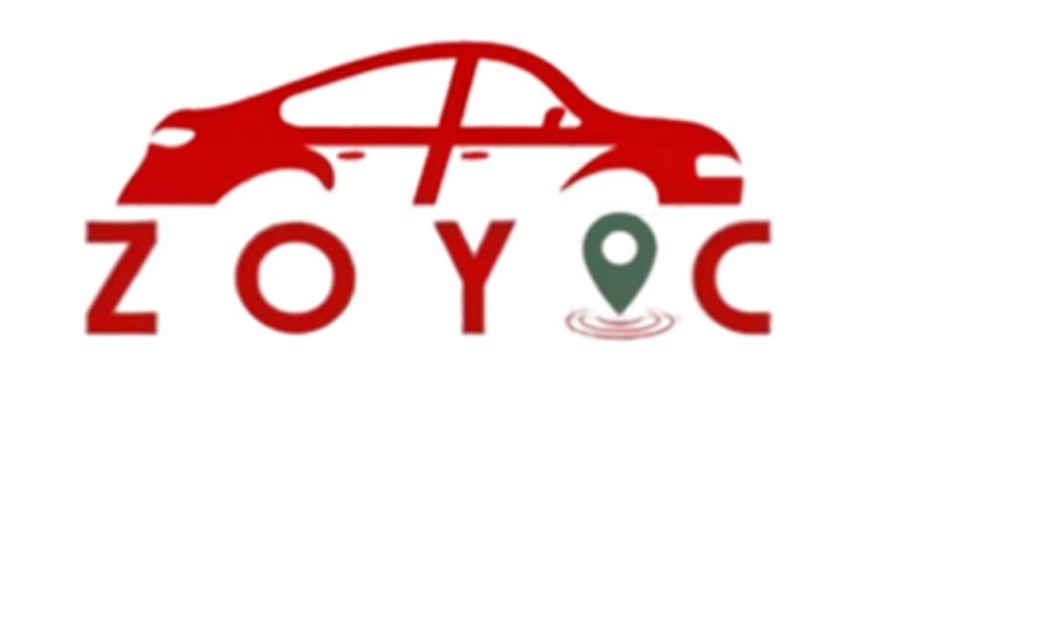

Slide 2
ZOYAC
Submitted by
Y.Asaruddeen(TU6220204112002)
M.Arthi(TU6220204111001)
D.Harish(TU6220204111003)
School of Computer Science

Slide 3
Abstract
The Zoyac project is developing a platform that connects passengers with multiple taxi service providers through a single, user-friendly interface. It offers features like ride booking, real-time availability updates, fare estimates, and automated payments. For taxi operators, Zoyac includes a robust backend for fleet management and performance tracking. By integrating these elements, Zoyac aims to enhance taxi service efficiency and provide a competitive alternative to ride-sharing options.

Slide 4
Hardware and Software Requirements
System | PC/Laptop/Mobile
Processor | Intel Core i3 / Intel Core i7/Dimensity 7050
RAM | 8.00 GB / 16.00 GB
ROM | SSD(512 GB)
Speaker | High-quality speaker
Mouse | Touch screen , Track pad
Graphics card | NVIDIA GeForce GTX 1660
Operating System | Windows 11 Pro
Front End | HTML, CSS, JavaScript ,Bootstrap
Back End | Python
Program | Python
IDE | PyCharm
Framework | Flask
Database | MySQL
Server | Local Server
System type | 64-bit operating system

Slide 5
Existing System
1. Traditional Taxi Booking: • Manual Dispatch: Taxis are dispatched manually by dispatchers who receive bookings via phone calls.
• Lack of Real-Time Tracking: Passengers and drivers do not have access to real-time information about each other's locations.
• Payment Methods: Payments are often handled in cash or require manual processing.
2. Existing Mobile Apps: • Limitations: These systems might not be available in all regions, and smaller local taxi services may struggle to compete.

Slide 6
Proposed System
1.System Architecture:
User Interface (UI): Passenger App: Allows users to book rides, track taxis in real-time, and make payments.
Driver App: Provides drivers with ride requests, navigation, and payment management.
Admin Panel: Manages user accounts, monitors activity, and handles disputes.

Slide 7
2.Features:
Real-Time Tracking: Passengers and drivers can view each other’s locations in real-time.
Ride Booking: Passengers can book rides, choose vehicle types, and schedule rides in advance.
Payment Integration: Supports multiple payment methods including credit/debit cards, mobile wallets, and cash.
Rating System: Users can rate and review drivers, helping maintain service quality.
Notifications: Real-time updates on ride status, driver arrival, and payment confirmations.

Slide 8
3.Technical Stack:
Frontend: Mobile apps developed using frameworks like Pycharm.
Backend: Server-side components built using Node.js, Python (Django/Flask).
Database: Relational databases like PostgreSQL or MySQL for storing user and ride data.

Slide 9
4.Security Measures:
Data Encryption: Ensures that all sensitive data is encrypted in transit and at rest.
User Authentication: Secure login methods, such as OAuth or multi-factor authentication.
Compliance: Adherence to relevant data protection regulations (e.g., GDPR).

Slide 10
Additional Considerations
1.User Support: • Provide customer support channels for handling inquiries and complaints.
2. Marketing and Adoption: • Develop a marketing strategy to promote Zoyac and attract users and drivers.
3. Scalability: • Plan for scaling the system to handle increased user load as the service grows.

